Slide 1
Session 10 –
Ajax: The Basics

Slide 2
Agenda
Ajax motivation
The basic Ajax process
Using dynamic content and JSP
Using dynamic content and servlets
Sending GET data
Sending POST data
Displaying HTML results
Parsing and displaying XML results
Toolkits

Slide 3
Motivation

Slide 4
Why Ajax?
HTML and HTTP are weak
  Non-interactive
  Coarse-grained updates
Everyone wants to use a browser
  Not a custom application
"Real" browser-based active content
  Failed: Java Applets
    Not universally supported; can't interact with the HTML
  Serious alternative: Flash (and Flex)
    Not yet universally supported; limited power
  New and unproven
    Microsoft Silverlight
    JavaFX
    Adobe Apollo

Slide 5
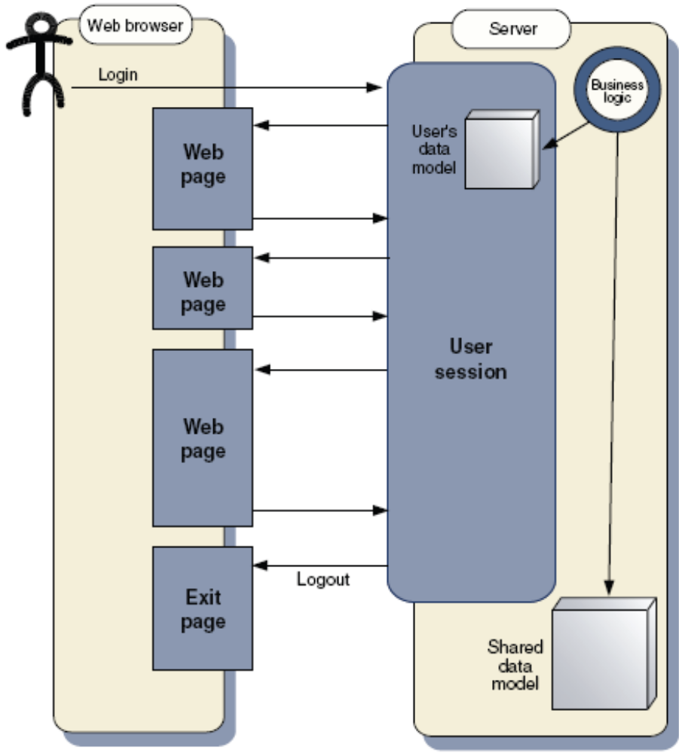
Lifecycle of a classic web application
All the state of
the user’s “conversation” with the application is held on the web
server.
The user sees a succession of pages, none of which can
advance the broader conversation without going back to the server.

Slide 6
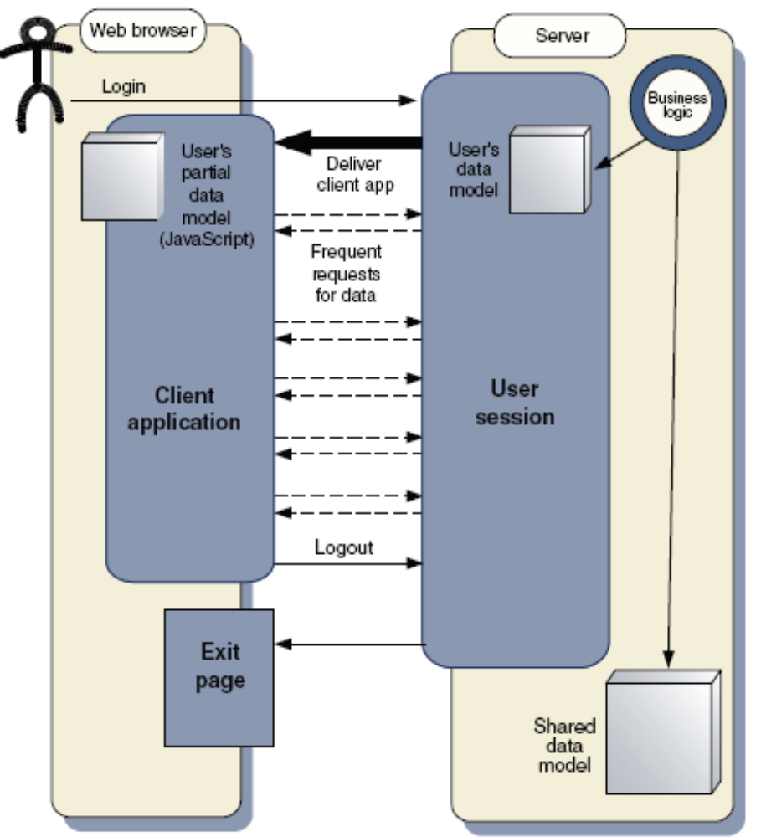
Lifecycle of an Ajax application
When the user logs
in, a client application is delivered to the browser.
This application can field many user interactions independently, or else send requests to the server behind the scenes, without interrupting the
user's workflow.

Slide 7
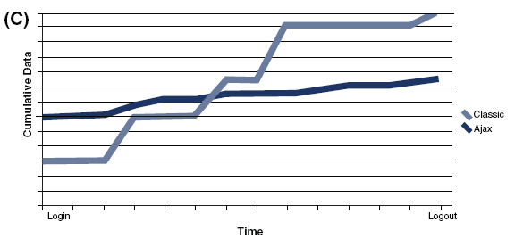
Advantage of Ajax on data sending

Slide 8
The Basic Process

Slide 9
The Basic Ajax Process
JavaScript
  Define an object for sending HTTP requests
  Initiate request
    Get request object
    Designate a request handler function
      Supply as onreadystatechange attribute of request
    Initiate a GET or POST request
    Send data
  Handle response
    Wait for readyState of 4 and HTTP status of 200
    Extract return text with responseText or responseXML
    Do something with result
HTML
  Loads JavaScript
  Designates control that initiates request
  Gives ids to input elements that will be read by script

Slide 10
Define a Request Object
var request;
function getRequestObject() {
if (window.ActiveXObject) {
return(new ActiveXObject("Microsoft.XMLHTTP"));
} else if (window.XMLHttpRequest) {
return(new XMLHttpRequest());
} else {
return(null);
}
}
Version for Internet Explorer
(IE 5 and later)
Version for Netscape, Firefox, and Opera
(Netscape 5 and later)
Fails on older and nonstandard browsers

Slide 11
Initiate Request
function sendRequest() {
request = getRequestObject();
request.onreadystatechange = handleResponse;
request.open("GET", "message-data.html", true);
request.send(null);
}
Response handler function name
URL of server-side resource
Don't wait for response
(Send request asynchronously)
POST data
(always null for GET)

Slide 12
Handle Response
function handleResponse() {
if (request.readyState == 4) {
alert(request.responseText);
}
}
Response is returned from server
(handler gets invoked multiple times)
Text of server response
Pop up dialog box

Slide 13
Complete JavaScript Code
(show-message.js)
var request;
function getRequestObject() {
if (window.ActiveXObject) {
return(new ActiveXObject("Microsoft.XMLHTTP"));
} else if (window.XMLHttpRequest) {
return(new XMLHttpRequest());
} else {
return(null);
}
}
function sendRequest() {
request = getRequestObject();
request.onreadystatechange = handleResponse;
request.open("GET", "message-data.html", true);
request.send(null);
}
function handleResponse() {
if (request.readyState == 4) {
alert(request.responseText);
}
}

Slide 14
Exercise
Given a file “Books.xml” to store data as you practice in lab session.
Write pages named “Ajax.html”, “Data.java” and “javascript.js” to load data from “Books.xml” and display them in Ajax.html by table format.

Slide 15
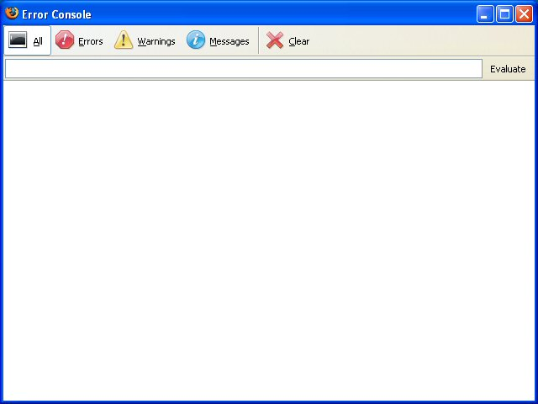
The Firefox JavaScript Console
Invoke with Control-Shift-J
Also see Venkman JavaScript debugger
  http://www.mozilla.org/projects/venkman/
  https://addons.mozilla.org/firefox/216/

Slide 16
HTML Code
Use xhtml, not HTML 4
  In order to manipulate it with DOM
    <!DOCTYPE html PUBLIC "-//W3C//DTD XHTML 1.0 Transitional//EN"
    "http://www.w3.org/TR/xhtml1/DTD/xhtml1-transitional.dtd">
    <html xmlns="http://www.w3.org/1999/xhtml">...</html>
    Due to IE bug, do not use XML header before the DOCTYPE
Load the JavaScript file
    <script src="relative-url-of-JavaScript-file"
    type="text/javascript"></script>
    Use separate </script> end tag
Designate control to initiate request
    <input type="button" value="button label"
    onclick="mainFunction()"/>

Slide 17
Internet Explorer XHTML Bugs
Can't handle XML header
  XML documents in general are supposed to start with XML header:
    <?xml version="1.0" encoding="UTF-8"?>
    <!DOCTYPE html ...>
    <html xmlns="http://www.w3.org/1999/xhtml">...</html>
  XHTML specification recommends using it
  But... Internet Explorer will switch to quirks-mode (from standards-mode) if DOCTYPE is not first line.
    Many recent style sheet formats will be ignored
    So omit XML header
Needs separate end tags in some places
  Scripts will not load if you use <script .../>
  instead of <script...></script>

Slide 18
HTML Code
(show-message.html)
<!DOCTYPE html PUBLIC "..."
"http://www.w3.org/TR/xhtml1/DTD/xhtml1-transitional.dtd">
<html xmlns="http://www.w3.org/1999/xhtml">
<head><title>Ajax: Simple Message</title>
<script src="show-message.js"
type="text/javascript"></script>
</head>
<body>
<center>
<table border="1" bgcolor="gray">
<tr><th><big>Ajax: Simple Message</big></th></tr>
</table>
<p/>
<form action="#">
<input type="button" value="Show Message"
onclick="sendRequest()"/>
</form>
</center></body></html>

Slide 19
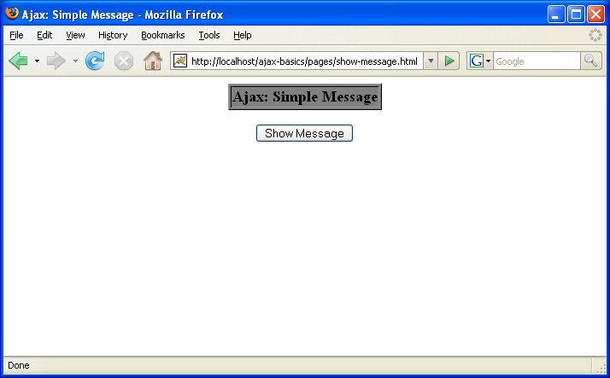
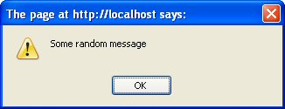
The Basic Process: Results

Slide 20
Dynamic Content from JSP

Slide 21
First Example: Design Deficiencies
Content was the same on each request
  Could have just hardcoded the alert value in JavaScript
  Instead, invoke a JSP page on the server
Resource address hardcoded in JavaScript
  Prevents functions from applying to multiple situations
  Instead, make generic function and pass address to it
JavaScript file was in same folder as HTML
  Makes it hard to reuse the JavaScript in different pages
  Instead, make a special directory for JavaScript
No style sheet was used
  Less for JavaScript to work with when manipulating page
  Use CSS for normal reasons as well as for JavaScript

Slide 22
Steps
JavaScript
  Define an object for sending HTTP requests
  Initiate request
    Get request object
    Designate a request handler function
      Supply as onreadystatechange attribute of request
    Initiate a GET or POST request to a JSP page
    Send data
  Handle response
    Wait for readyState of 4 and HTTP status of 200
    Extract return text with responseText or responseXML
    Do something with result
HTML
  Loads JavaScript from centralized directory
  Designates control that initiates request
  Gives ids to input elements that will be read by script

Slide 23
Define a Request Object
var request;
function getRequestObject() {
if (window.ActiveXObject) {
return(new ActiveXObject("Microsoft.XMLHTTP"));
} else if (window.XMLHttpRequest) {
return(new XMLHttpRequest());
} else {
return(null);
}
}
No changes from previous example

Slide 24
Initiate Request
function sendRequest(address) {
request = getRequestObject();
request.onreadystatechange = showResponseAlert;
request.open("GET", address, true);
request.send(null);
}
Relative URL of server-side resource.
(In this example, we will pass in the address of a JSP page.)

Slide 25
Handle Response
function showResponseAlert() {
if ((request.readyState == 4) &&
(request.status == 200)) {
alert(request.responseText);
}
}
Server response came back with no errors.
(HTTP status code 200.)

Slide 26
Complete JavaScript Code
(Part of ajax-basics.js)
var request;
function getRequestObject() {
if (window.ActiveXObject) {
return(new ActiveXObject("Microsoft.XMLHTTP"));
} else if (window.XMLHttpRequest) {
return(new XMLHttpRequest());
} else {
return(null);
}
}
function sendRequest(address) {
request = getRequestObject();
request.onreadystatechange = showResponseAlert;
request.open("GET", address, true);
request.send(null);
}
function showResponseAlert() {
if ((request.readyState == 4) &&
(request.status == 200)) {
alert(request.responseText);
}
}

Slide 27
HTML Code
Loads JavaScript from central location
    <script src="../scripts/ajax-basics.js"
    type="text/javascript"></script>
Passes JSP address to main function
    <input type="button" value="Show Server Time"
    onclick='sendRequest("show-time.jsp")'/>
Uses style sheet
    <link rel="stylesheet"
    href="../css/styles.css"
    type="text/css"/>
Note single quotes
(Because of double quotes inside parens.)

Slide 28
HTML Code
(show-time-1.html)
<!DOCTYPE html PUBLIC "..."
"http://www.w3.org/...">
<html xmlns="http://www.w3.org/1999/xhtml">
<head><title>Ajax: Time</title>
<link rel="stylesheet"
href="../css/styles.css"
type="text/css"/>
<script src="../scripts/ajax-basics.js"
type="text/javascript"></script>
</head>
<body>
...
<form action="#">
<input type="button" value="Show Server Time"
onclick='sendRequest("show-time.jsp")'/>
</form>
</center></body></html>

Slide 29
JSP Code (show-time.jsp)
<%= new java.util.Date() %>
Note: executing this example
  You must run from Tomcat.
    Otherwise JSP cannot execute
    Otherwise status code is -1, not 200

Slide 30
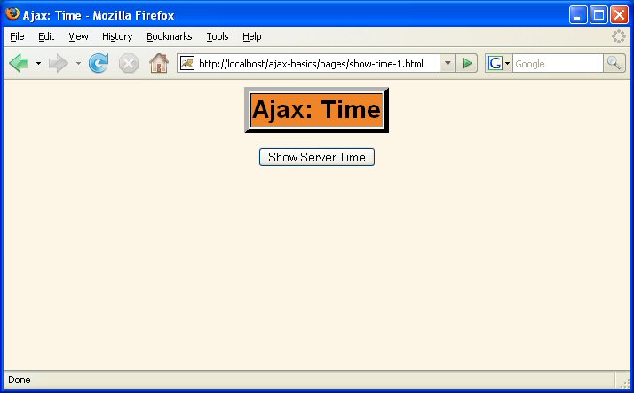
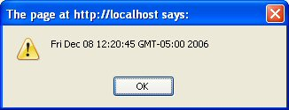
Message from JSP: Results

Slide 31
Dynamic Content from Servlet

Slide 32
JSP Example: Design Deficiencies
Caching problems
  The URL stays the same but the output changes
  So if browser caches page, you get the wrong time
  Solution: send Cache-Control and Pragma headers
Date was not formatted
  Just used the toString method of Date
  Solution: use String.format (sprintf) and %t controls
JSP is wrong technology
  JSP is best for lots of HTML and little or no logic/Java
  But now we have logic but no HTML
  Solution: use a servlet

Slide 33
Steps
JavaScript
  Define an object for sending HTTP requests
  Initiate request
    Get request object
    Designate a request handler function
      Supply as onreadystatechange attribute of request
    Initiate a GET or POST request to a servlet
    Send data
  Handle response
    Wait for readyState of 4 and HTTP status of 200
    Extract return text with responseText or responseXML
    Do something with result
HTML
  Loads JavaScript from centralized directory
  Designates control that initiates request
  Gives ids to input elements that will be read by script

Slide 34
Define a Request Object
var request;
function getRequestObject() {
if (window.ActiveXObject) {
return(new ActiveXObject("Microsoft.XMLHTTP"));
} else if (window.XMLHttpRequest) {
return(new XMLHttpRequest());
} else {
return(null);
}
}
No changes from previous example

Slide 35
Initiate Request
function sendRequest(address) {
request = getRequestObject();
request.onreadystatechange = showResponseAlert;
request.open("GET", address, true);
request.send(null);
}
No changes from previous example

Slide 36
Handle Response
function showResponseAlert() {
if ((request.readyState == 4) &&
(request.status == 200)) {
alert(request.responseText);
}
}
No changes from previous example

Slide 37
HTML Code
(show-time-2.html)
<!DOCTYPE html PUBLIC "..."
"http://www.w3.org/...">
<html xmlns="http://www.w3.org/1999/xhtml">
<head><title>Ajax: Time</title>
<link rel="stylesheet"
href="../css/styles.css"
type="text/css"/>
<script src="../scripts/ajax-basics.js"
type="text/javascript"></script>
</head>
<body>
...
<form action="#">
<input type="button" value="Show Server Time"
onclick='sendRequest("../show-time")'/>
</form>
</center></body></html>
Address of servlet.
(From url-pattern of
servlet-mapping.)

Slide 38
Servlet Code
package coreservlets;
import ...
public class ShowTime extends HttpServlet {
public void doGet(HttpServletRequest request,
HttpServletResponse response)
throws ServletException, IOException {
response.setHeader("Cache-Control", "no-cache");
response.setHeader("Pragma", "no-cache");
response.setContentType("text/html");
PrintWriter out = response.getWriter();
Date currentTime = new Date();
String message =
String.format("It is now %tr on %tD.",
currentTime, currentTime);
out.print(message);
}
}

Slide 39
web.xml
...
<servlet>
<servlet-name>ShowTime</servlet-name>
<servlet-class>coreservlets.ShowTime</servlet-class>
</servlet>
<servlet-mapping>
<servlet-name>ShowTime</servlet-name>
<url-pattern>/show-time</url-pattern>
</servlet-mapping>
...

Slide 40
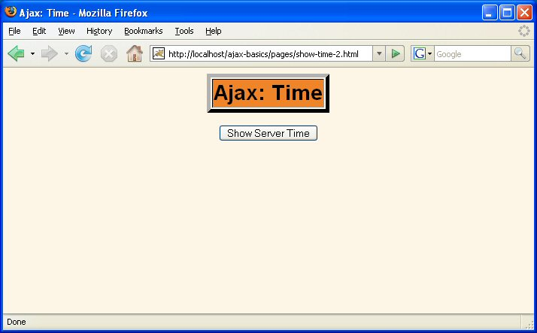
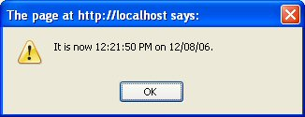
Message from Servlet: Results

Slide 41
Sending GET Data

Slide 42
Servlet Example:
Design Deficiencies
No data sent from HTML page to servlet
  Solution: attach data to end of the URL (GET data)
    Use normal GET format:
      mainaddress?var1=val1&var2=val2

Slide 43
Steps
JavaScript
  Define an object for sending HTTP requests
  Initiate request
    Get request object
    Designate a request handler function
      Supply as onreadystatechange attribute of request
    Initiate a GET request to a servlet
      URL has GET data attached at the end
    Send data
  Handle response
    Wait for readyState of 4 and HTTP status of 200
    Extract return text with responseText or responseXML
    Do something with result
HTML
  Loads JavaScript from centralized directory
  Designates control that initiates request
  Gives ids to input elements that will be read by script

Slide 44
JavaScript Code
No changes from previous example

Slide 45
HTML Code
(show-time-3.html)
<!DOCTYPE html PUBLIC "..."
"http://www.w3.org/...">
<html xmlns="http://www.w3.org/1999/xhtml">
<head><title>Ajax: Time</title>
<link rel="stylesheet"
href="../css/styles.css"
type="text/css"/>
<script src="../scripts/ajax-basics.js"
type="text/javascript"></script>
</head>
<body>
...
<form action="#">
<input type="button" value="Show Time in Chicago"
onclick=
'sendRequest("../show-time-in-city?city=Chicago")'/>
</form>
</center></body></html>

Slide 46
Servlet Code
public class ShowTimeInCity extends HttpServlet {
public void doGet(HttpServletRequest request,
HttpServletResponse response)
throws ServletException, IOException {
response.setHeader("Cache-Control", "no-cache");
response.setHeader("Pragma", "no-cache");
response.setContentType("text/html");
PrintWriter out = response.getWriter();
String city = request.getParameter("city");
...
String message = TimeZone.getTimeString(city);
...
out.print(message);
}
...
}

Slide 47
TimeZone Class
Maintains a list of cities and associated time zones
  Given the name of a city, it finds the difference in hours between that city's time and server time (east coast US)
Computes server time
  Using standard GregorianCalendar class
Converts to time in that city
  By calling the "add" method with the timezone offset
Formats the time and day
  Using String.format with %tr and %tD

Slide 48

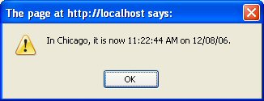
Sending GET Data: Results

Slide 49
Sending POST Data

Slide 50
GET Example: Design Deficiencies
City name was always Chicago
  Solution: read data from textfield
Data sent by GET
  Sometimes POST is preferred
  Solution: use POST instead of GET
GET vs. POST
  In normal Web pages, there are compelling reasons for choosing POST or GET
    POST: simpler URL, data hidden from people looking over your shoulder, larger amounts of data can be sent
    GET: can bookmark results page
  With Ajax, end users don't see URL, so choice is relatively arbitrary
    Unless there is a very large amount of data

Slide 51
Steps
JavaScript
  Define an object for sending HTTP requests
  Initiate request
    Get request object
    Designate a request handler function
      Supply as onreadystatechange attribute of request
    Initiate a POST request to a servlet
      Put data to the "send" function
    Send data
  Handle response
    Wait for readyState of 4 and HTTP status of 200
    Extract return text with responseText or responseXML
    Do something with result
HTML
  Loads JavaScript from centralized directory
  Designates control that initiates request
  Gives ids to input elements that will be read by script

Slide 52
Sending POST Data in JavaScript
Collect data from form
  Give ids to input elements
    <input type="text" id="some-id"/>
  Read data
    var value1 = document.getElementById("some-id").value;
  URL-encode data and form into query string
    var data = "var1=" + escape(value1);
Specify POST instead of GET in "open"
    request.open("POST", address, true);
Specify form encoding type
    request.setRequestHeader("Content-Type",
    "application/x-www-form-urlencoded");
Supply data in "send"
    request.send(data);

Slide 53
Define a Request Object
var request;
function getRequestObject() {
if (window.ActiveXObject) {
return(new ActiveXObject("Microsoft.XMLHTTP"));
} else if (window.XMLHttpRequest) {
return(new XMLHttpRequest());
} else {
return(null);
}
}
No changes from previous example

Slide 54
Initiate Request
function sendRequestWithData(address, data,
responseHandler) {
request = getRequestObject();
request.onreadystatechange = responseHandler;
request.open("POST", address, true);
request.setRequestHeader("Content-Type",
"application/x-www-form-urlencoded");
request.send(data);
}
function showTimeInCity() {
var address = "../show-time-in-city";
var city = document.getElementById("city").value;
var data = "city=" + escape(city);
sendRequestWithData(address, data, showResponseAlert);
}
No changes from previous example

Slide 55
Handle Response
function showResponseAlert() {
if ((request.readyState == 4) &&
(request.status == 200)) {
alert(request.responseText);
}
}
No changes from previous example

Slide 56
HTML Code
<!DOCTYPE html PUBLIC "..."
"http://www.w3.org/...">
<html xmlns="http://www.w3.org/1999/xhtml">
<head><title>Ajax: Time</title>
<link rel="stylesheet"
href="../css/styles.css"
type="text/css"/>
<script src="../scripts/ajax-basics.js"
type="text/javascript"></script>
</head>
<body>
...
<form action="#">
City: <input type="text" id="city"/><br/>
<input type="button" value="Show Time in City"
onclick="showTimeInCity()"/>
</form>
</center></body></html>

Slide 57
Servlet Code
public class ShowTimeInCity extends HttpServlet {
public void doGet(HttpServletRequest request,
HttpServletResponse response)
throws ServletException, IOException {
response.setHeader("Cache-Control", "no-cache");
response.setHeader("Pragma", "no-cache");
response.setContentType("text/html");
PrintWriter out = response.getWriter();
String city = request.getParameter("city");
...
String message = TimeZone.getTimeString(city);
...
out.print(message);
}
public void doPost(HttpServletRequest request,
HttpServletResponse response)
throws ServletException, IOException {
doGet(request, response);
}
}

Slide 58
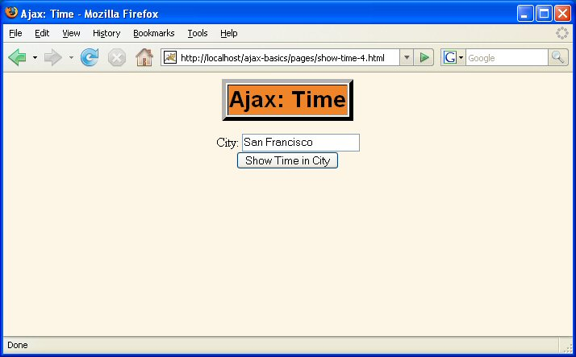
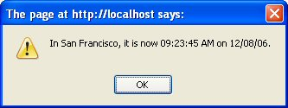
Sending POST Data: Results

Slide 59
Displaying HTML Output

Slide 60
POST Example:
Design Deficiencies
Results always shown in dialog (alert) box
  Alerts usually reserved for errors or warnings
  Users prefer normal results inside page
  Solution: use DOM to update page with result text

Slide 61
Steps
JavaScript
  Define an object for sending HTTP requests
  Initiate request
    Get request object
    Designate a request handler function
    Initiate a POST request to a servlet
    Send data
  Handle response
    Wait for readyState of 4 and HTTP status of 200
    Extract return text with responseText or responseXML
    Do something with result
      Use innerHTML to insert result into "div" element
HTML
  Loads JavaScript from centralized directory
  Designates control that initiates request
  Gives ids to input elements that will be read by script
  Defines a blank "div" element with a known id

Slide 62
Updating HTML Page Asynchronously
HTML
  Defines initially blank div element
    <div id="resultText"></div>
JavaScript
  Finds element (getElementById)
  and inserts text into innerHTML property
    document.getElementById("resultText").innerHTML =
    request.responseText;

Slide 63
Define a Request Object
var request;
function getRequestObject() {
if (window.ActiveXObject) {
return(new ActiveXObject("Microsoft.XMLHTTP"));
} else if (window.XMLHttpRequest) {
return(new XMLHttpRequest());
} else {
return(null);
}
}
No changes from previous example

Slide 64
Initiate Request
function sendRequestWithData(address, data,
responseHandler) {
request = getRequestObject();
request.onreadystatechange = responseHandler;
request.open("POST", address, true);
request.setRequestHeader("Content-Type",
"application/x-www-form-urlencoded");
request.send(data);
}
function displayTimeInCity() {
var address = "../show-time-in-city";
var city = document.getElementById("city").value;
var data = "city=" + escape(city) + "&useHTML=true";
sendRequestWithData(address, data, showResponseText);
}
No changes from previous example

Slide 65
Handle Response
function showResponseText() {
if ((request.readyState == 4) &&
(request.status == 200)) {
document.getElementById("resultText").innerHTML =
request.responseText;
}
}

Slide 66
HTML Code
(show-time-5.html)
<!DOCTYPE html PUBLIC "..." "http://www.w3.org/...">
<html xmlns="http://www.w3.org/1999/xhtml">
<head><title>Ajax: Time</title>
<link rel="stylesheet".../>
<script src="../scripts/ajax-basics.js"
type="text/javascript"></script>
</head>
<body>
...
<form action="#">
City: <input type="text" id="city"/><br/>
<input type="button" value="Display Time in City"
onclick="displayTimeInCity()"/>
</form>
<div id="resultText"></div>
</center></body></html>

Slide 67
Servlet Code
public class ShowTimeInCity extends HttpServlet {
public void doGet(HttpServletRequest request,
HttpServletResponse response)
throws ServletException, IOException {
response.setHeader("Cache-Control", "no-cache");
response.setHeader("Pragma", "no-cache");
response.setContentType("text/html");
PrintWriter out = response.getWriter();
String city = request.getParameter("city");
boolean useHTML = false;
if (request.getParameter("useHTML") != null) {
useHTML = true;
}
String message = TimeZone.getTimeString(city);
if (useHTML) {
message = String.format("<h2>%s</h2>", message);
}
out.print(message);
}
public void doPost(...) ... { doGet(request, response); }
}

Slide 68
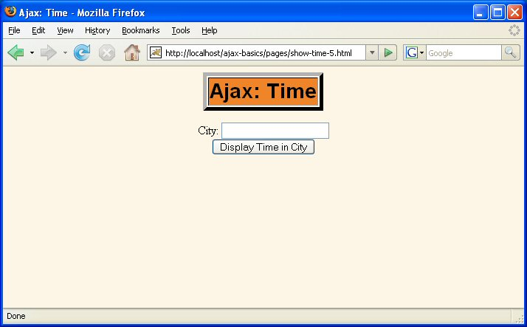
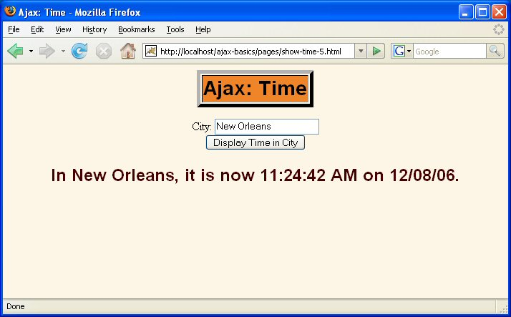
Displaying HTML Output: Results

Slide 69
Parsing and Displaying XML Output

Slide 70
HTML Example:
Design Deficiencies
Java code generated HTML
  Page author has no control over format
  Cannot use the same data for different tasks
  Having server-side resource (servlet) generate HTML is often easier and better. But not always.
Solution
  Have servlet return XML content
  JavaScript parses XML and decides what to do with it
Secondary problem
  Generating XML from a servlet is inconvenient
Secondary solution
  Use MVC architecture on server
    Servlet creates dynamic data
    JSP formats the data
    See detailed lecture on using MVC in Java:
    http://courses.coreservlets.com/Course-Materials/csajsp2.html

Slide 71
Steps
JavaScript
  Define an object for sending HTTP requests
  Initiate request
    Get request object
    Designate a request handler function
    Initiate a POST request to a servlet (that uses MVC)
    Send data
  Handle response
    Wait for readyState of 4 and HTTP status of 200
    Extract return text with responseText or responseXML
    Do something with result
      Parse data. Use innerHTML to insert result into "div" element
HTML
  Loads JavaScript from centralized directory
  Designates control that initiates request
  Gives ids to input elements that will be read by script
  Defines a blank "div" element with a known id

Slide 72
Parsing XML in JavaScript
Getting the main XML document
  Use responseXML instead of responseText
    var xmlDocument = request.responseXML;
  Get array of elements with getElementsByTagName
    var names = xmlDocument.getElementsByTagName("name");
  Get body text by getting value of first child node
    for(var i=0; i<names.length; i++) {
    var name = names[i].childNodes[0].nodeValue;
    doSomethingWith(name);
    }
See detailed lecture on parsing XML
with DOM in Java
  http://courses.coreservlets.com/
  Course-Materials/java5.html
  Java API and JavaScript API are very similar

Slide 73
Define a Request Object
var request;
function getRequestObject() {
if (window.ActiveXObject) {
return(new ActiveXObject("Microsoft.XMLHTTP"));
} else if (window.XMLHttpRequest) {
return(new XMLHttpRequest());
} else {
return(null);
}
}
No changes from previous example

Slide 74
Initiate Request
function sendRequest() {
request = getRequestObject();
request.onreadystatechange = showCityTable;
request.open("POST", "../show-times-in-cities", true);
request.setRequestHeader("Content-Type",
"application/x-www-form-urlencoded");
var timezone = document.getElementById("timezone").value;
request.send("timezone=" + timezone);
}

Slide 75
Handle Response
function showCityTable() {
if ((request.readyState == 4) &&
(request.status == 200)) {
var xmlDocument = request.responseXML;
var names = xmlDocument.getElementsByTagName("name");
var times = xmlDocument.getElementsByTagName("time");
var days = xmlDocument.getElementsByTagName("day");
var tableData = getTableStart();
for(var i=0; i<names.length; i++) {
var name = names[i].childNodes[0].nodeValue;
var time = times[i].childNodes[0].nodeValue;
var day = days[i].childNodes[0].nodeValue;
tableData = tableData + getRowData(name, time, day);
}
tableData = tableData + getTableEnd();
document.getElementById("resultText").innerHTML =
tableData;
}
}

Slide 76
Auxiliary Functions
function getTableStart() {
return("<table border='1'>\n" +
" <tr><th>City</th><th>Time</th><th>Day</th></tr>\n");
}
function getRowData(name, time, day) {
return(" <tr><td>" + name +
"</td><td>" + time +
"</td><td>" + day +
"</td></tr>\n");
}
function getTableEnd() {
return("</table>\n");
}

Slide 77
Servlet Code
response.setHeader("Cache-Control", "no-cache");
response.setHeader("Pragma", "no-cache");
response.setContentType("text/xml");
String timezone = request.getParameter("timezone");
List legalZones =
Arrays.asList("eastern", "central", "mountain", "pacific");
if ((timezone == null) || (!legalZones.contains(timezone))) {
timezone = "eastern";
}
timezone = timezone.toLowerCase();
String outputPage =
String.format("/WEB-INF/results/%s.jsp", timezone);
FormattedTimeAndDay timeAndDay =
new FormattedTimeAndDay(timezone);
request.setAttribute("timeAndDay", timeAndDay);
RequestDispatcher dispatcher =
request.getRequestDispatcher(outputPage);
dispatcher.include(request, response);

Slide 78
JSP Code (eastern.jsp)
<?xml version="1.0" encoding="UTF-8"?>
<cities>
<city>
<name>New York</name>
<time>${timeAndDay.time}</time>
<day>${timeAndDay.day}</day>
</city>
<city>
<name>Philadelphia</name>
<time>${timeAndDay.time}</time>
<day>${timeAndDay.day}</day>
</city>
<city>
<name>Boston</name>
<time>${timeAndDay.time}</time>
<day>${timeAndDay.day}</day>
</city>
</cities>

Slide 79

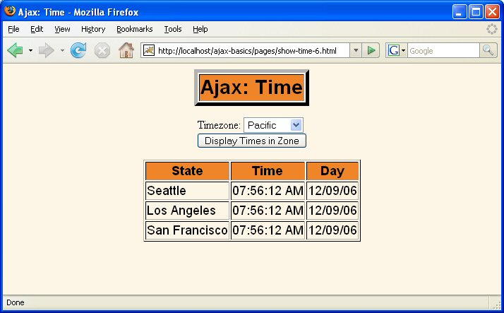
Parsing and Displaying XML Output: Results

Slide 80
Ajax Tools

Slide 81
Tools and Toolkits
Client-Side Tools
  Dojo.
    Open source JavaScript toolkit with Ajax support
    http://www.dojotoolkit.org/
  Google Web Toolkit
    Write code in Java, translate it to JavaScript
    http://code.google.com/webtoolkit/
  script.aculo.us
    Free JavaScript toolkit with Ajax support
    http://script.aculo.us/
  Yahoo User Interface Library (YUI)
    Free JavaScript toolkit with some Ajax support
    http://developer.yahoo.com/yui/

Slide 82
Tools and Toolkits (Continued)
Server-Side Tools
  Direct Web Remoting
    Lets you call Java methods semi-directly from JavaScript
    http://getahead.ltd.uk/dwr/
  JSON/JSON-RPC
    For sending data to/from JavaScript with less parsing
    http://www.json.org/
    http://json-rpc.org/
  JSP custom tag libraries
    Create tags that generate into HTML and JavaScript
    http://courses.coreservlets.com/Course-Materials/msajsp.html

Slide 83
Tools and Toolkits (Continued)
Hybrid Client/Server Tools
  AjaxTags (built on top of script.aculo.us)
    JSP custom tags that generate Ajax functionality
      Supports many powerful Ajax capabilities with very simple syntax
      http://ajaxtags.sourceforge.net
  JavaServer Faces (JSF) component libraries
    Trinidad (formerly Oracle ADF)
      http://www.oracle.com/technology/products/jdev/htdocs/
      partners/addins/exchange/jsf/ (also myfaces.apache.org)
    Tomahawk
      http://myfaces.apache.org/tomahawk/
    Ajax4JSF
      http://labs.jboss.com/jbossajax4jsf/
    IceFaces
      http://www.icefaces.org/
    Build your own
      http://courses.coreservlets.com/Course-Materials/jsf.html

Slide 84
Books
Foundations of Ajax
  Asleson and Schutta. APress.
  Geared around Java on the server-side.
Ajax in Action
  Crane, Pascarello, and James. Manning.
  Geared around Java on the server-side.
Pro JSF and Ajax
  Jacobi and Fallows. APress.
  Geared around JavaServer Faces integration.
Professional Ajax
  Zakas, et al. Wrox. Wait for 2nd edition.
  Geared around Java on the server-side.

Slide 85
Summary
JavaScript
  Define request object
    Check for both Microsoft and non-MS objects. Identical in all apps.
  Initiate request
    Get request object
    Designate a request handler function
    Initiate a GET or POST request
    Send data (null for GET)
  Handle response
    Wait for readyState of 4 and HTTP status of 200
    Extract return text with responseText or responseXML
    Do something with result
      Use innerHTML to insert result into "div" element
HTML
  Give ids to input elements and to div. Initiate process.
Java
  Use JSP, servlet, or combination (MVC) as appropriate.

